Slide 1
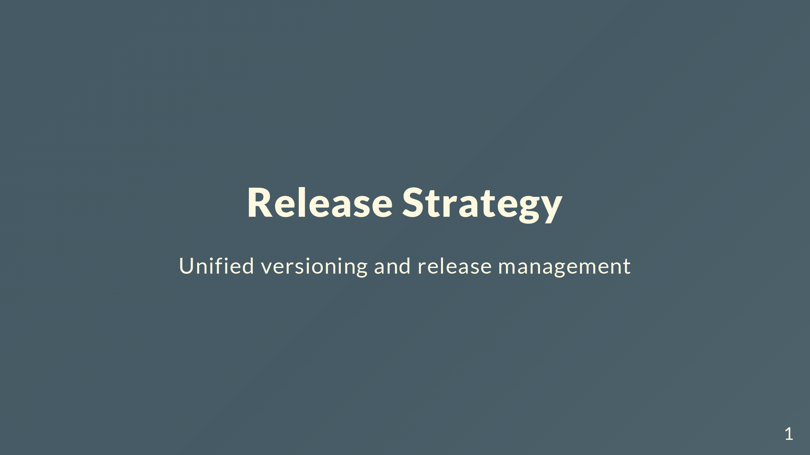
Notes:
We're going to talk about changing how we do releases. Moving away from release-please to something more explicit with unified versioning. First, where are we now?

Slide 2
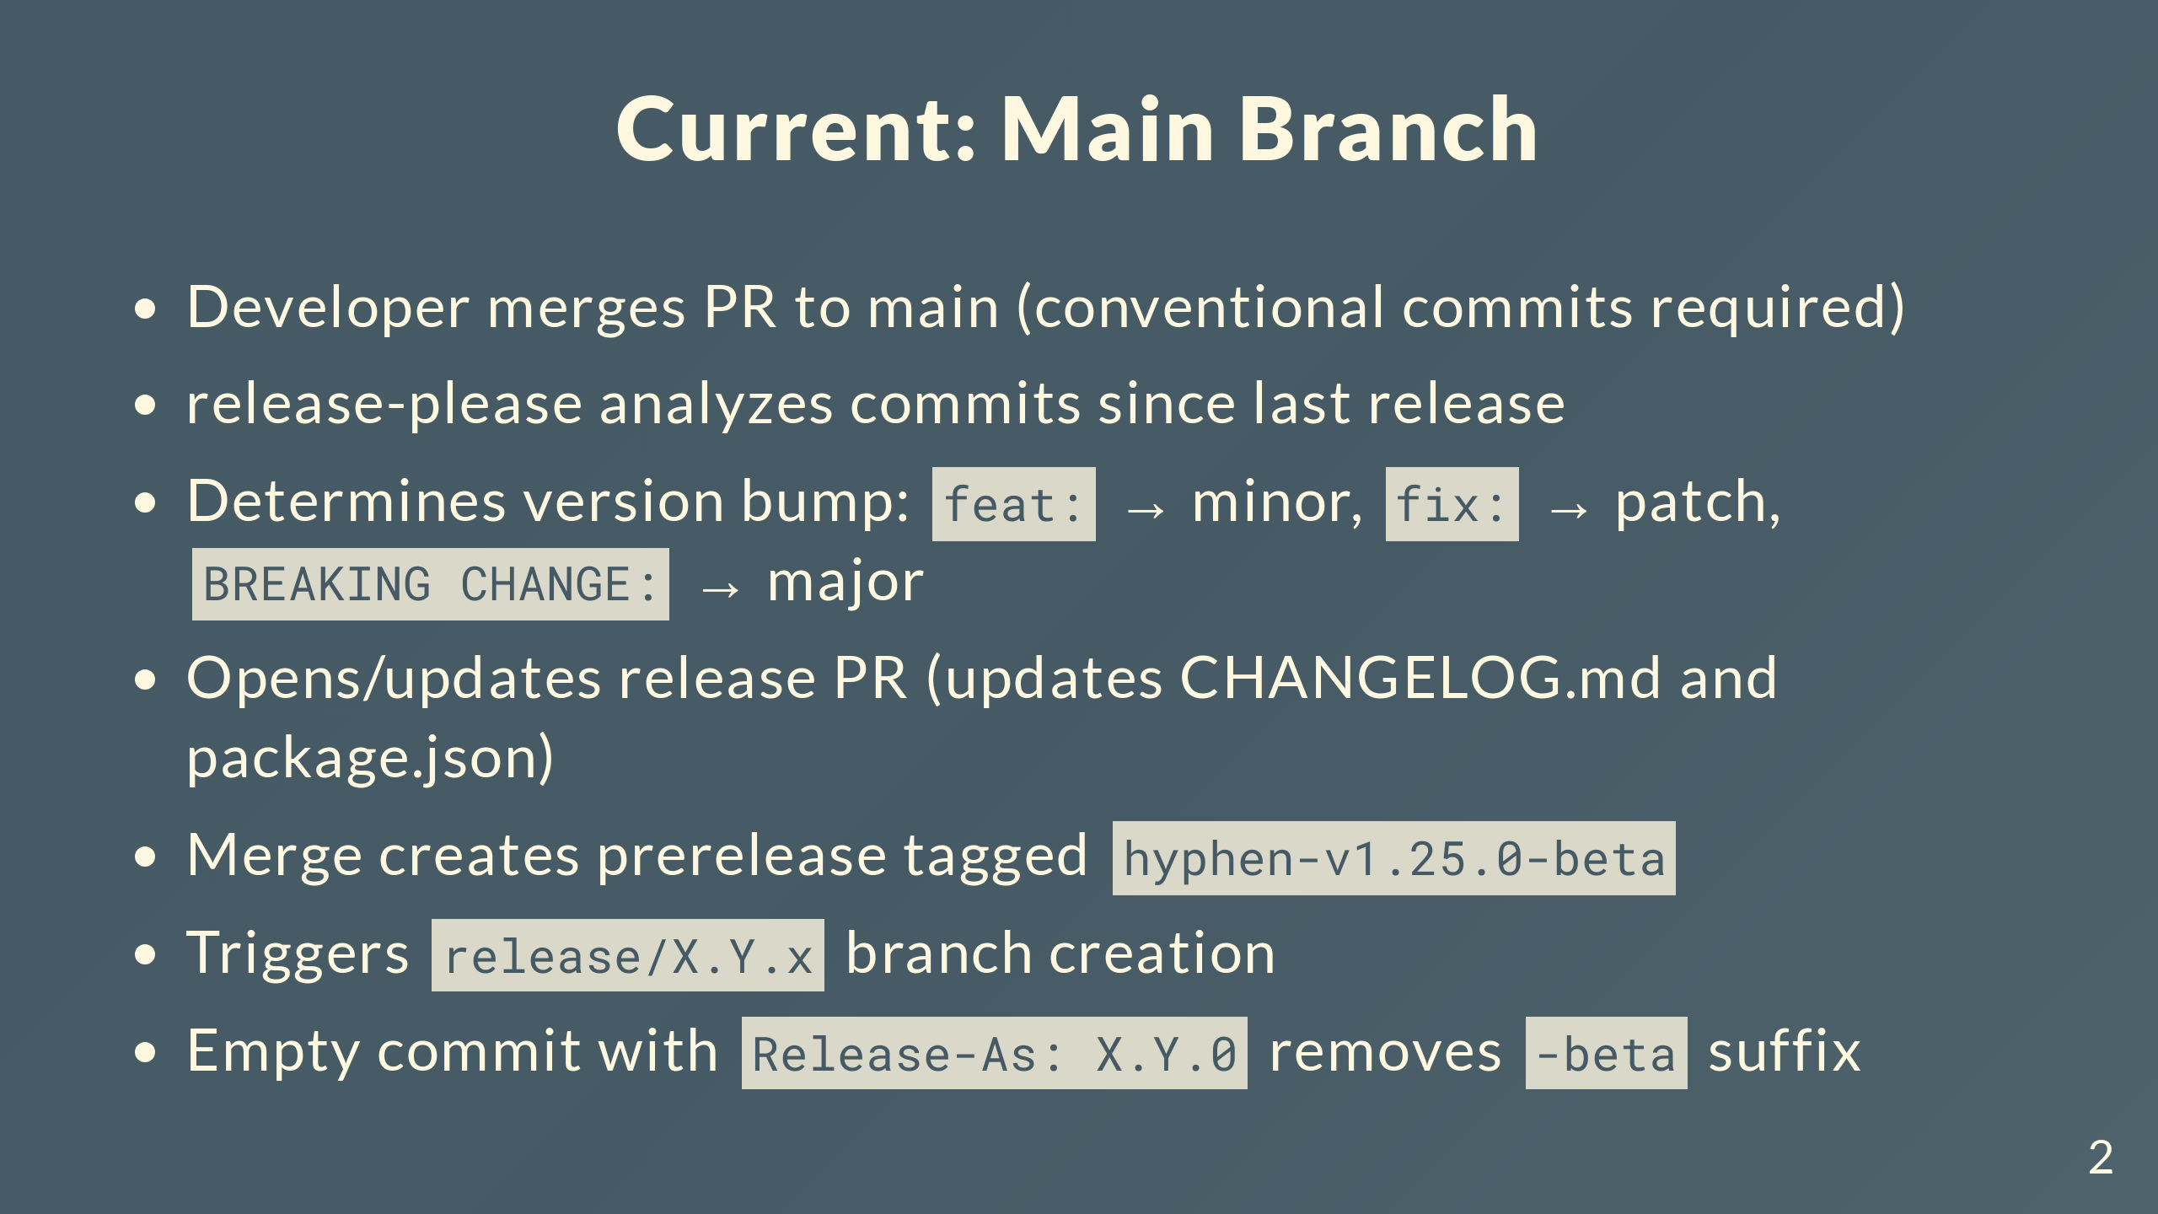
Notes:
Conventional commits are required - feat, fix, chore, etc. release-please scans all commits since last release and figures out the version bump. Opens a PR that updates the changelog and package.json. When you merge that PR, creates a GitHub release marked as prerelease with the -beta suffix, like hyphen-v1.25.0-beta. That triggers a workflow that creates the release branch. Makes an empty commit with Release-As to tell release-please to bump it to stable and strip the -beta.

Slide 3
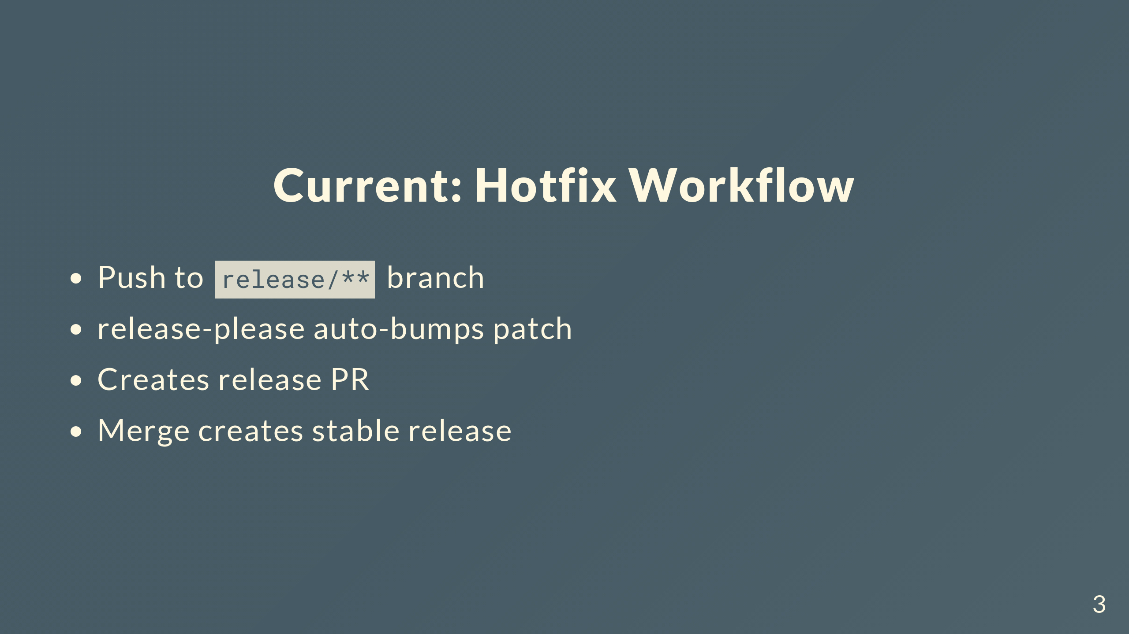
Notes:
Hotfixes work by pushing to release branches and it always bumps patch. The automation's been good, but we've outgrown it in some ways.

Slide 4
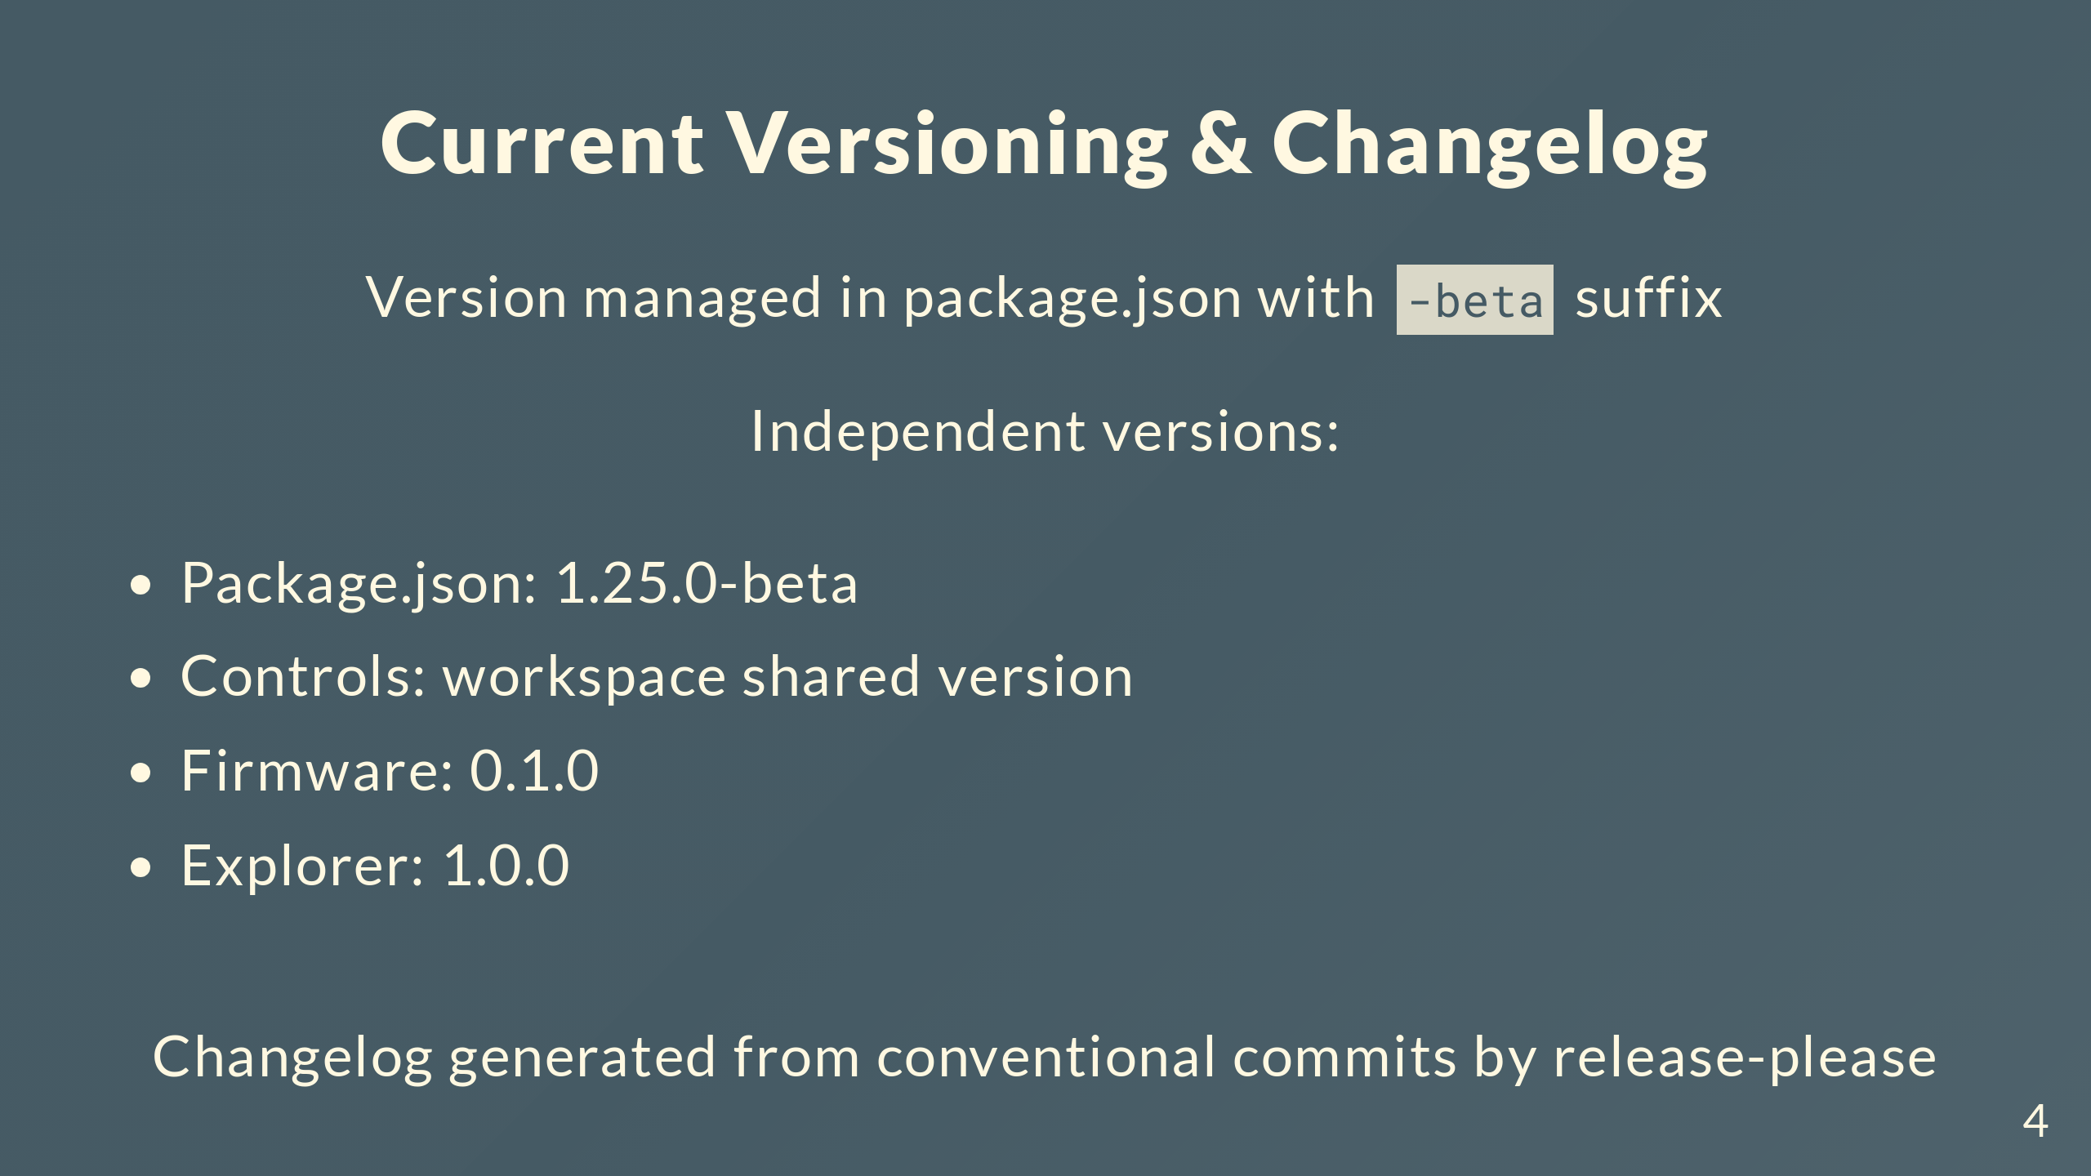
Notes:
Version lives in package.json mostly, but each workspace does its own thing. Package.json is 1.25.0-beta, controls apps are at 0.1.0, firmware's 0.1.0, explorer's 1.0.0. Changelog gets generated from conventional commits automatically.

Slide 5
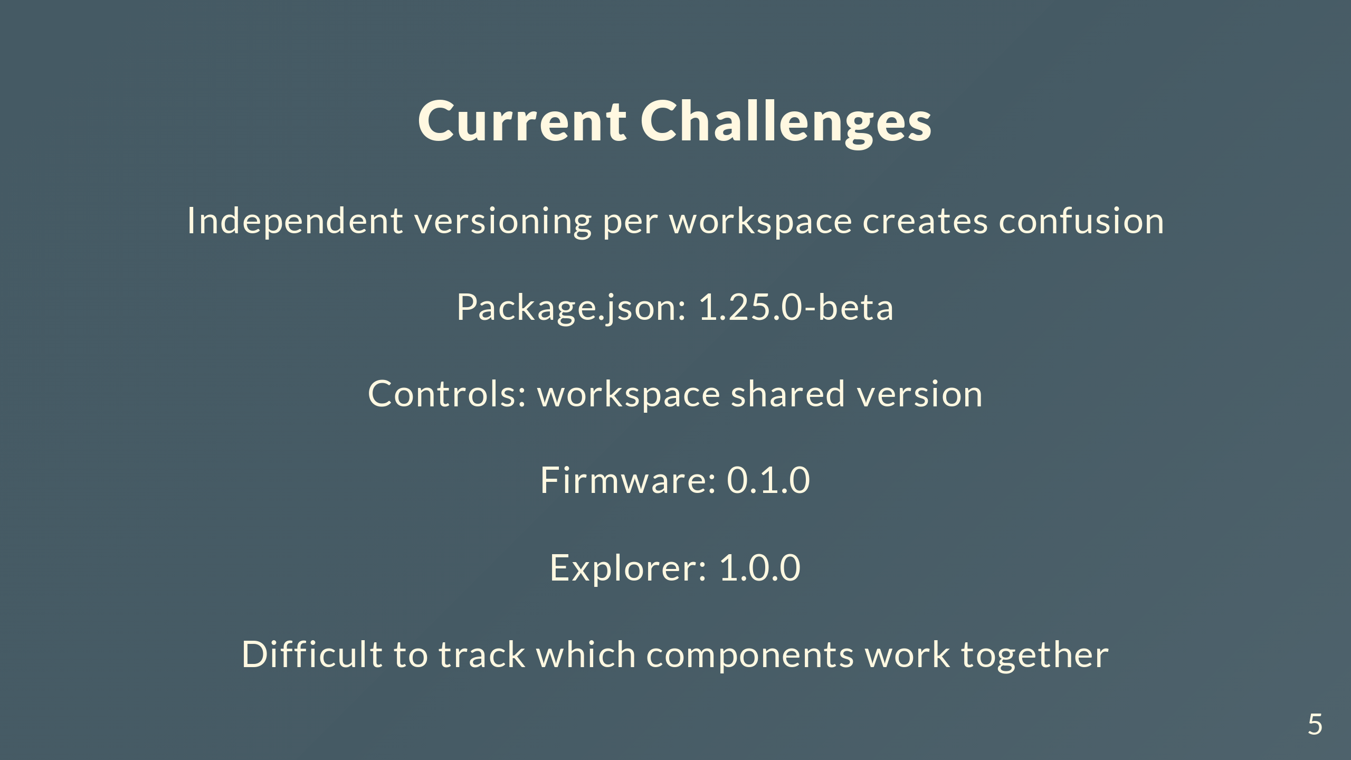
Notes:
Main problem is you can't tell what goes with what. Someone asks "what firmware version works with controls 0.1.0?" and we can't give a straight answer. No single version that tells you the state of everything at once.

Slide 6
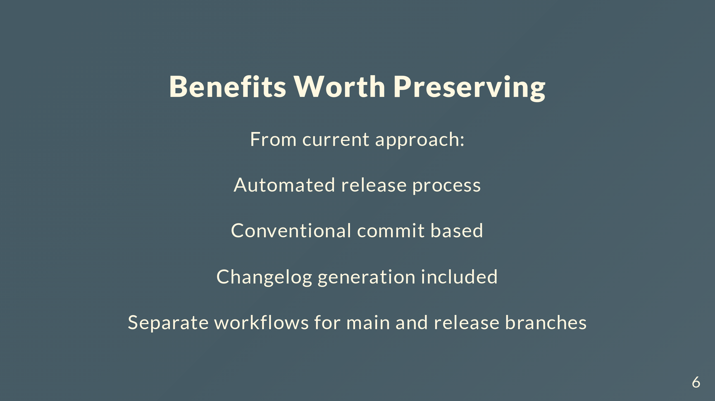
Notes:
Current setup does have things we want to keep. Not manually editing changelogs and versions is huge. Conventional commits keep things consistent. Separate workflows for main and release branches makes sense. Keep all that, fix the versioning mess.

Slide 7
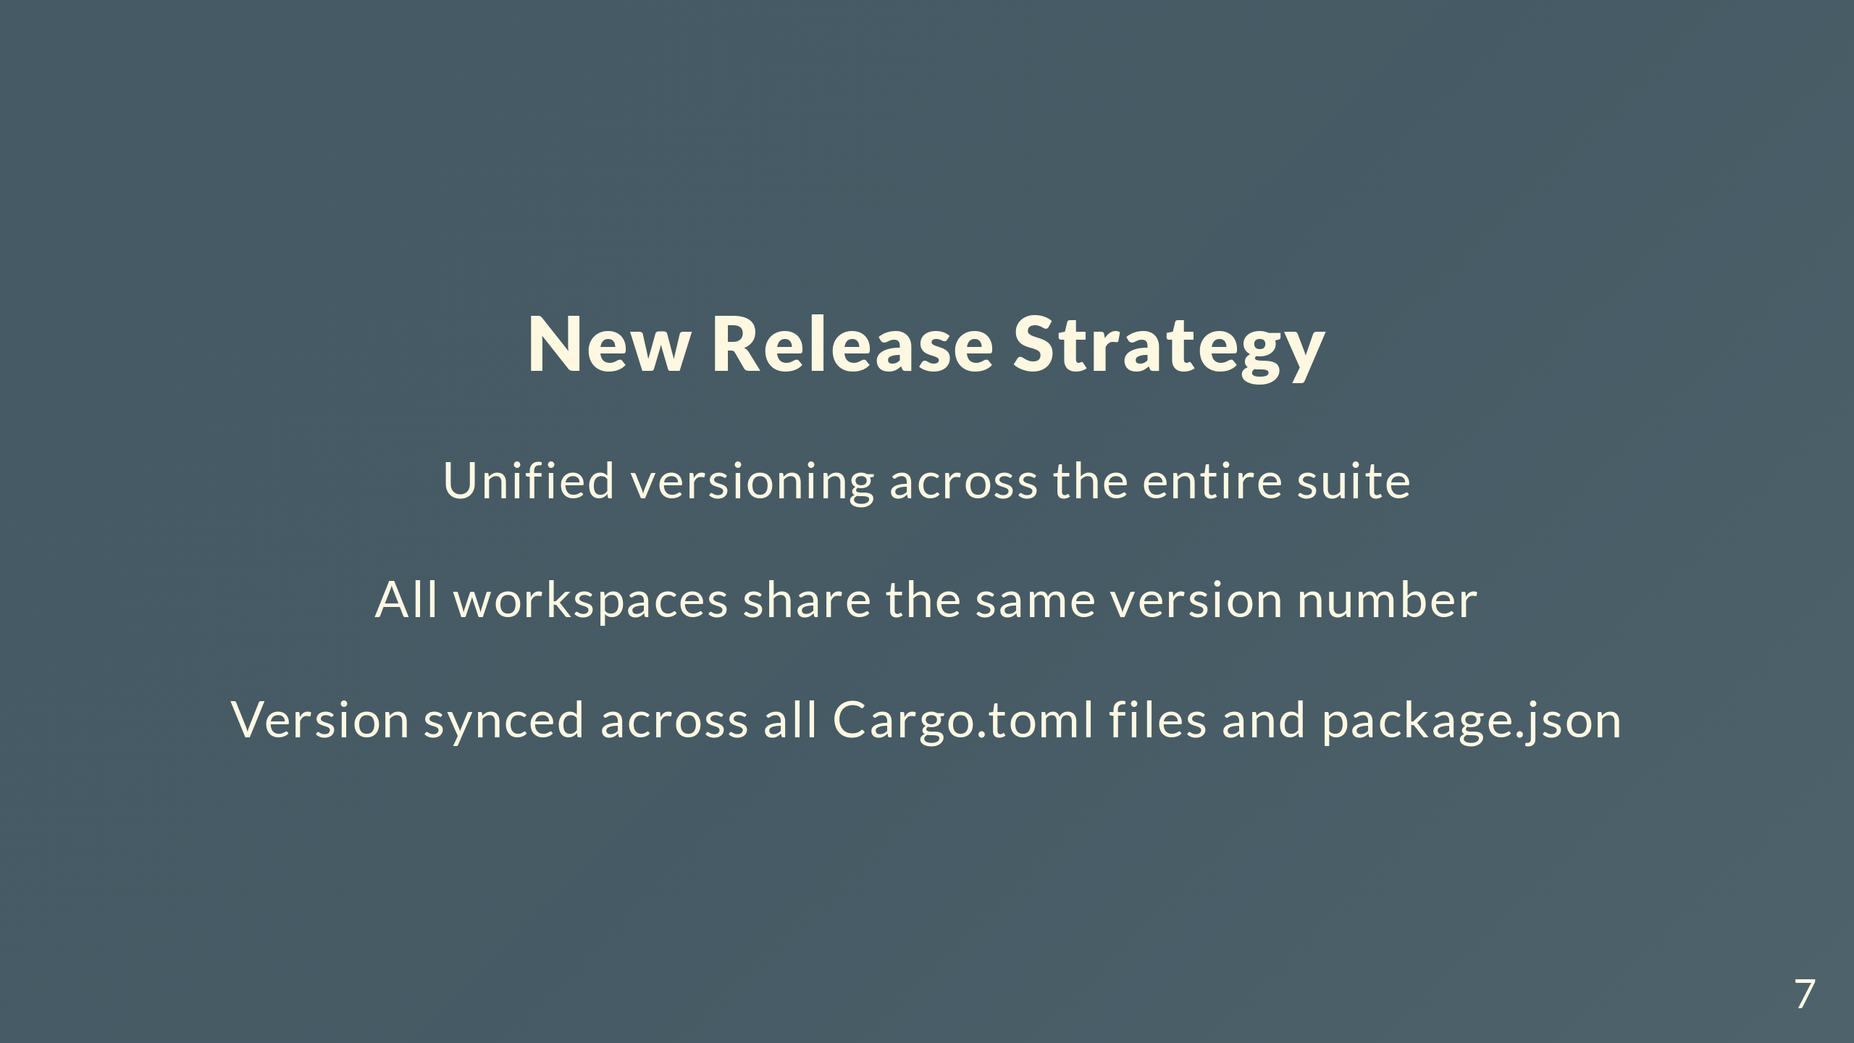
Notes:
New approach is simple: one version for everything. Package.json, all the Cargo.toml files, firmware, explorer - same version. Say "version 1.26.0" and you know exactly what you're getting for every component.

Slide 8
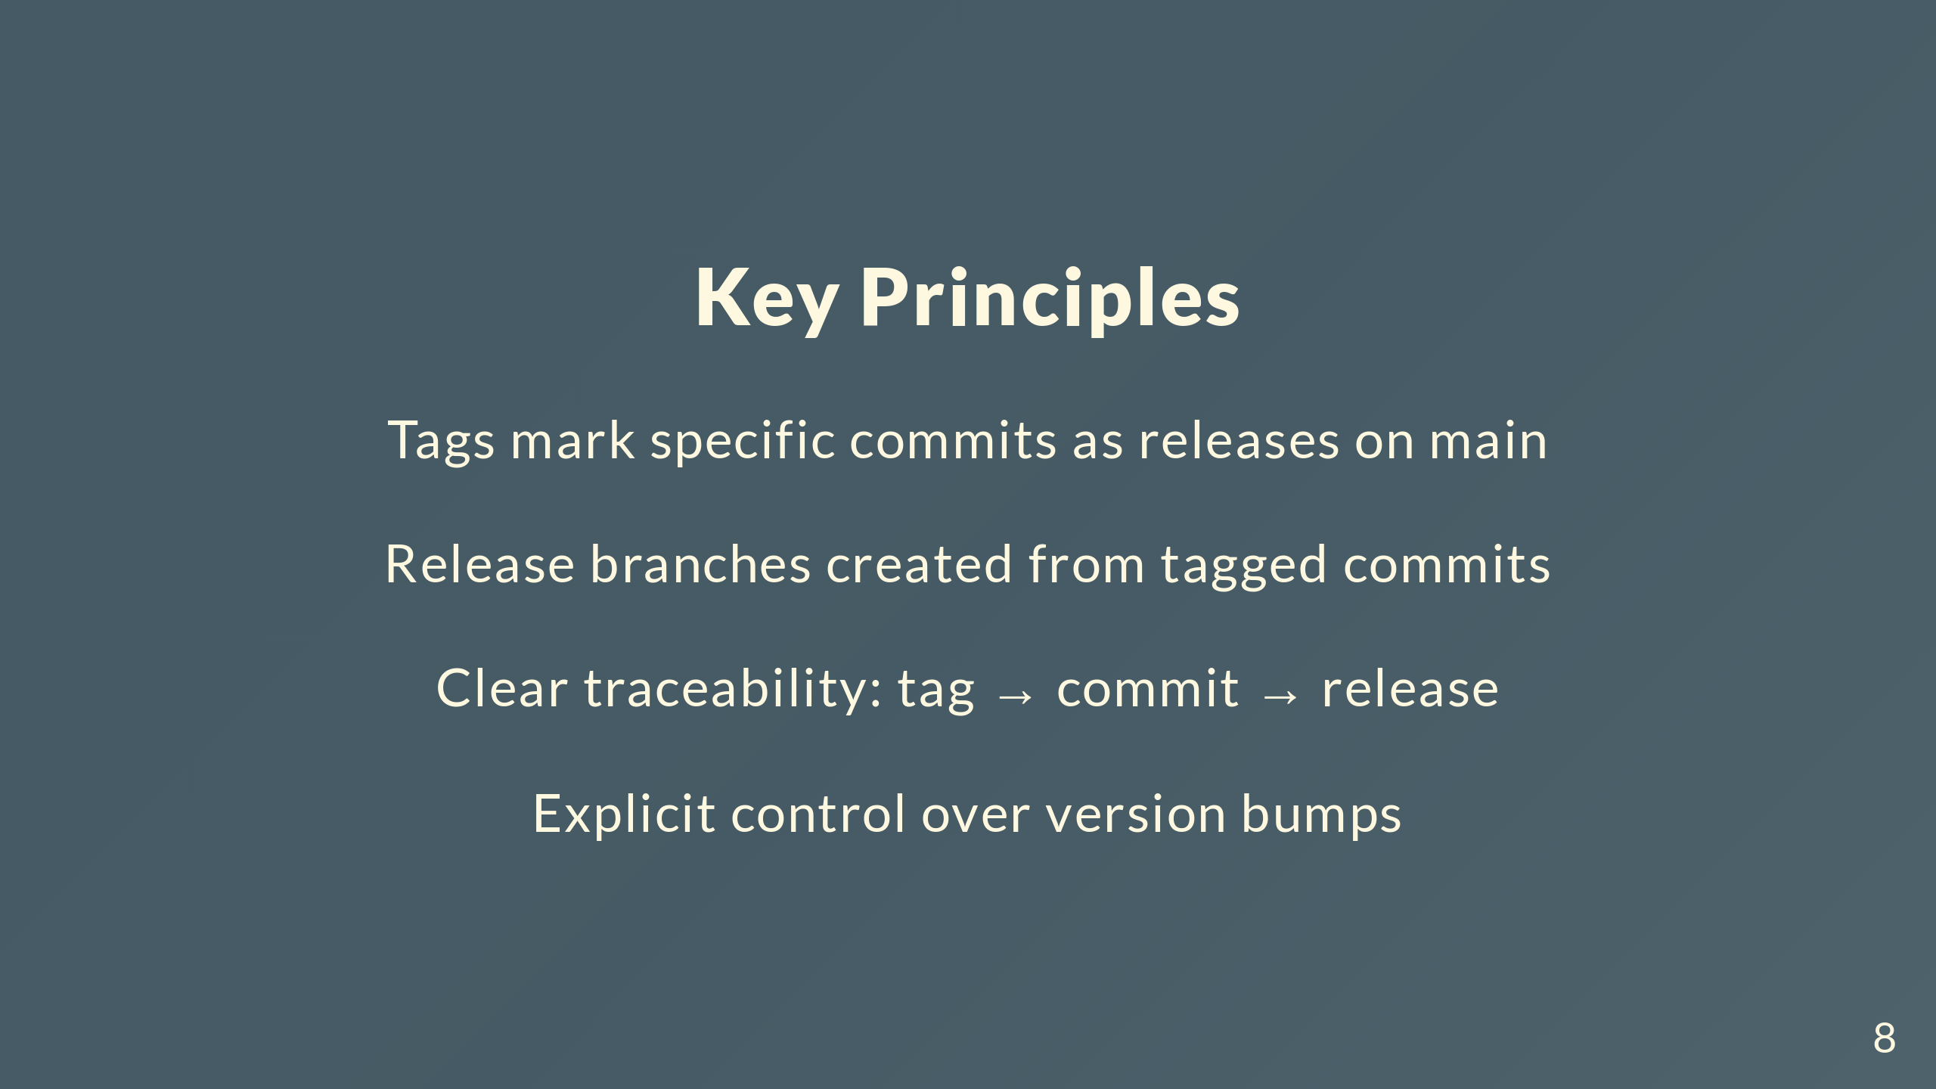
Notes:
Big change is releases become explicit instead of automatic. Tag commits on main, that's a release. Release branches come from those tagged commits. You can trace any release back to the exact commit on main. We decide version bumps instead of letting release-please figure it out.

Slide 9
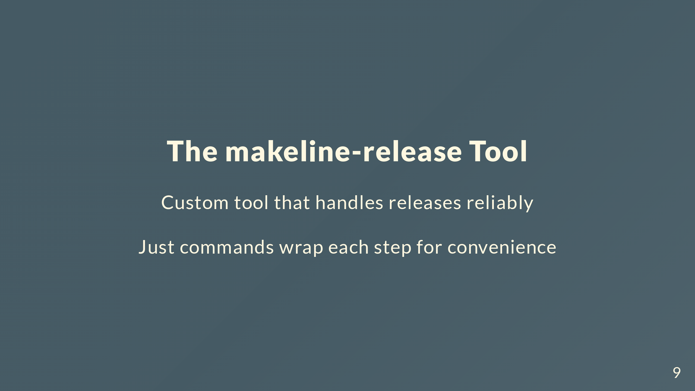
Notes:
Built makeline-release to handle this. Rust tool that updates versions, generates changelogs, creates tags and branches. Wrapped it in Just commands so you just run stuff like bump-minor-version, create-release-branch.

Slide 10
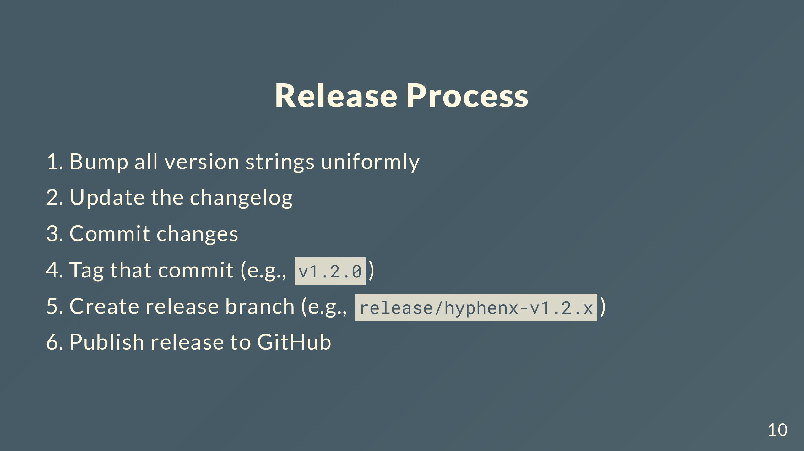
Notes:
New workflow goes like this. Run a bump command, updates all 5 version spots and regenerates the changelog. Commits it. Tag that commit. Create a release branch from the tag. Publish to GitHub. Each step you control.

Slide 11
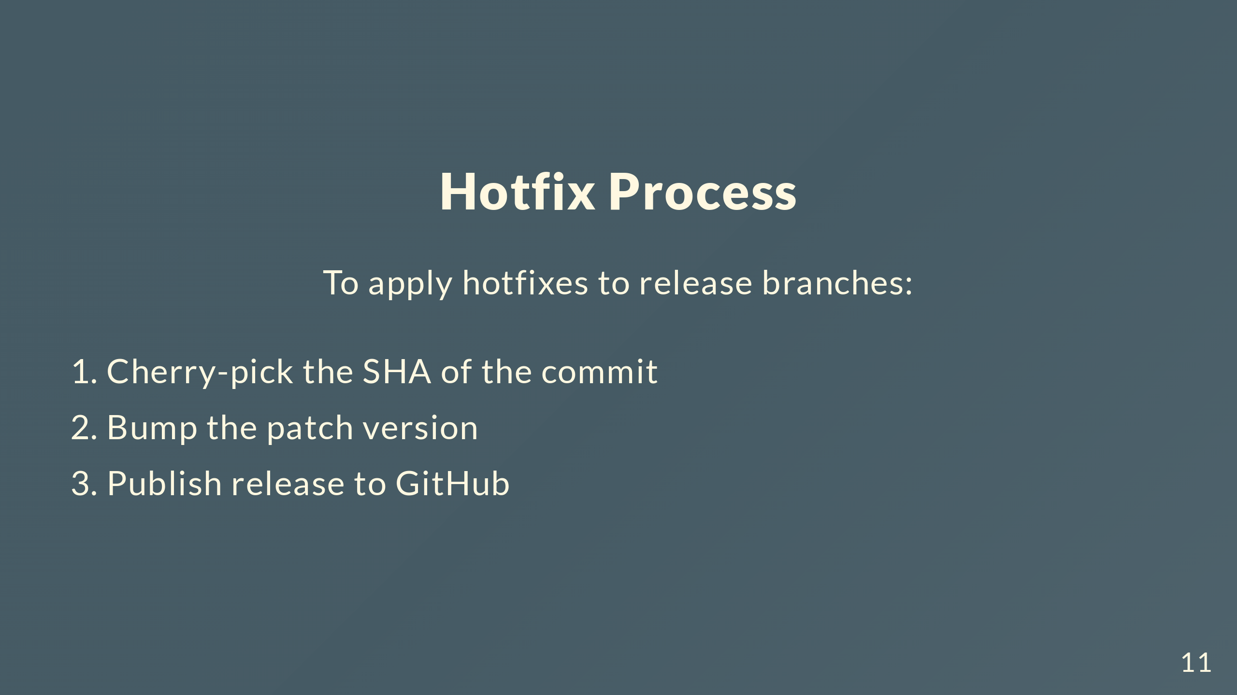
Notes:
Hotfixes are simple. Cherry-pick the commit to the release branch. Run the hotfix command, bumps patch. Publish. Done.

Slide 12
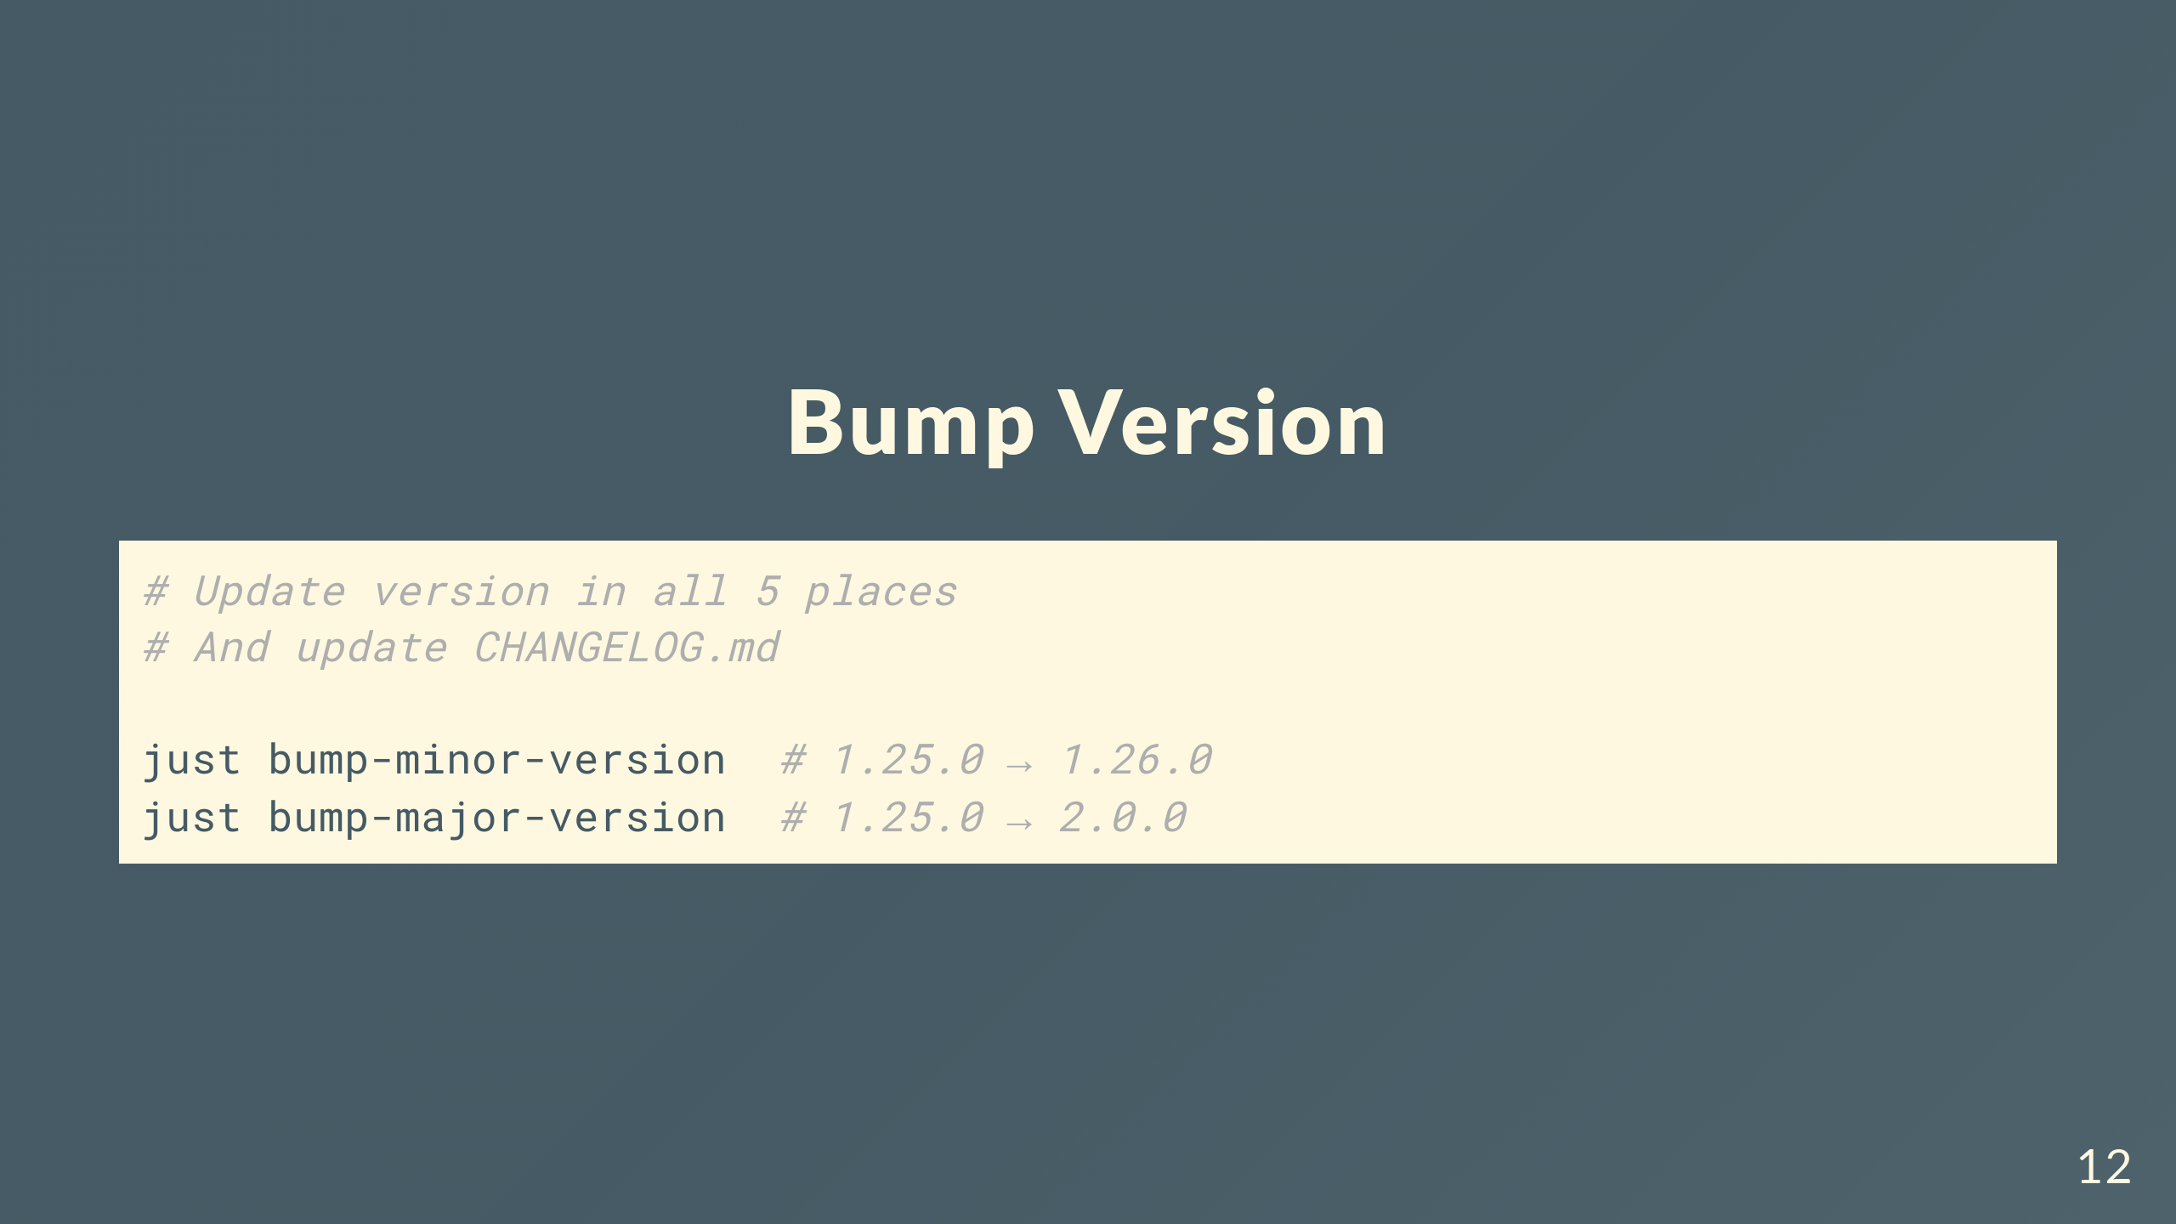
Notes:
Actual commands. Bump version with just bump-minor-version or bump-major-version. Updates all 5 places, regenerates CHANGELOG.md. One command, atomic.

Slide 13
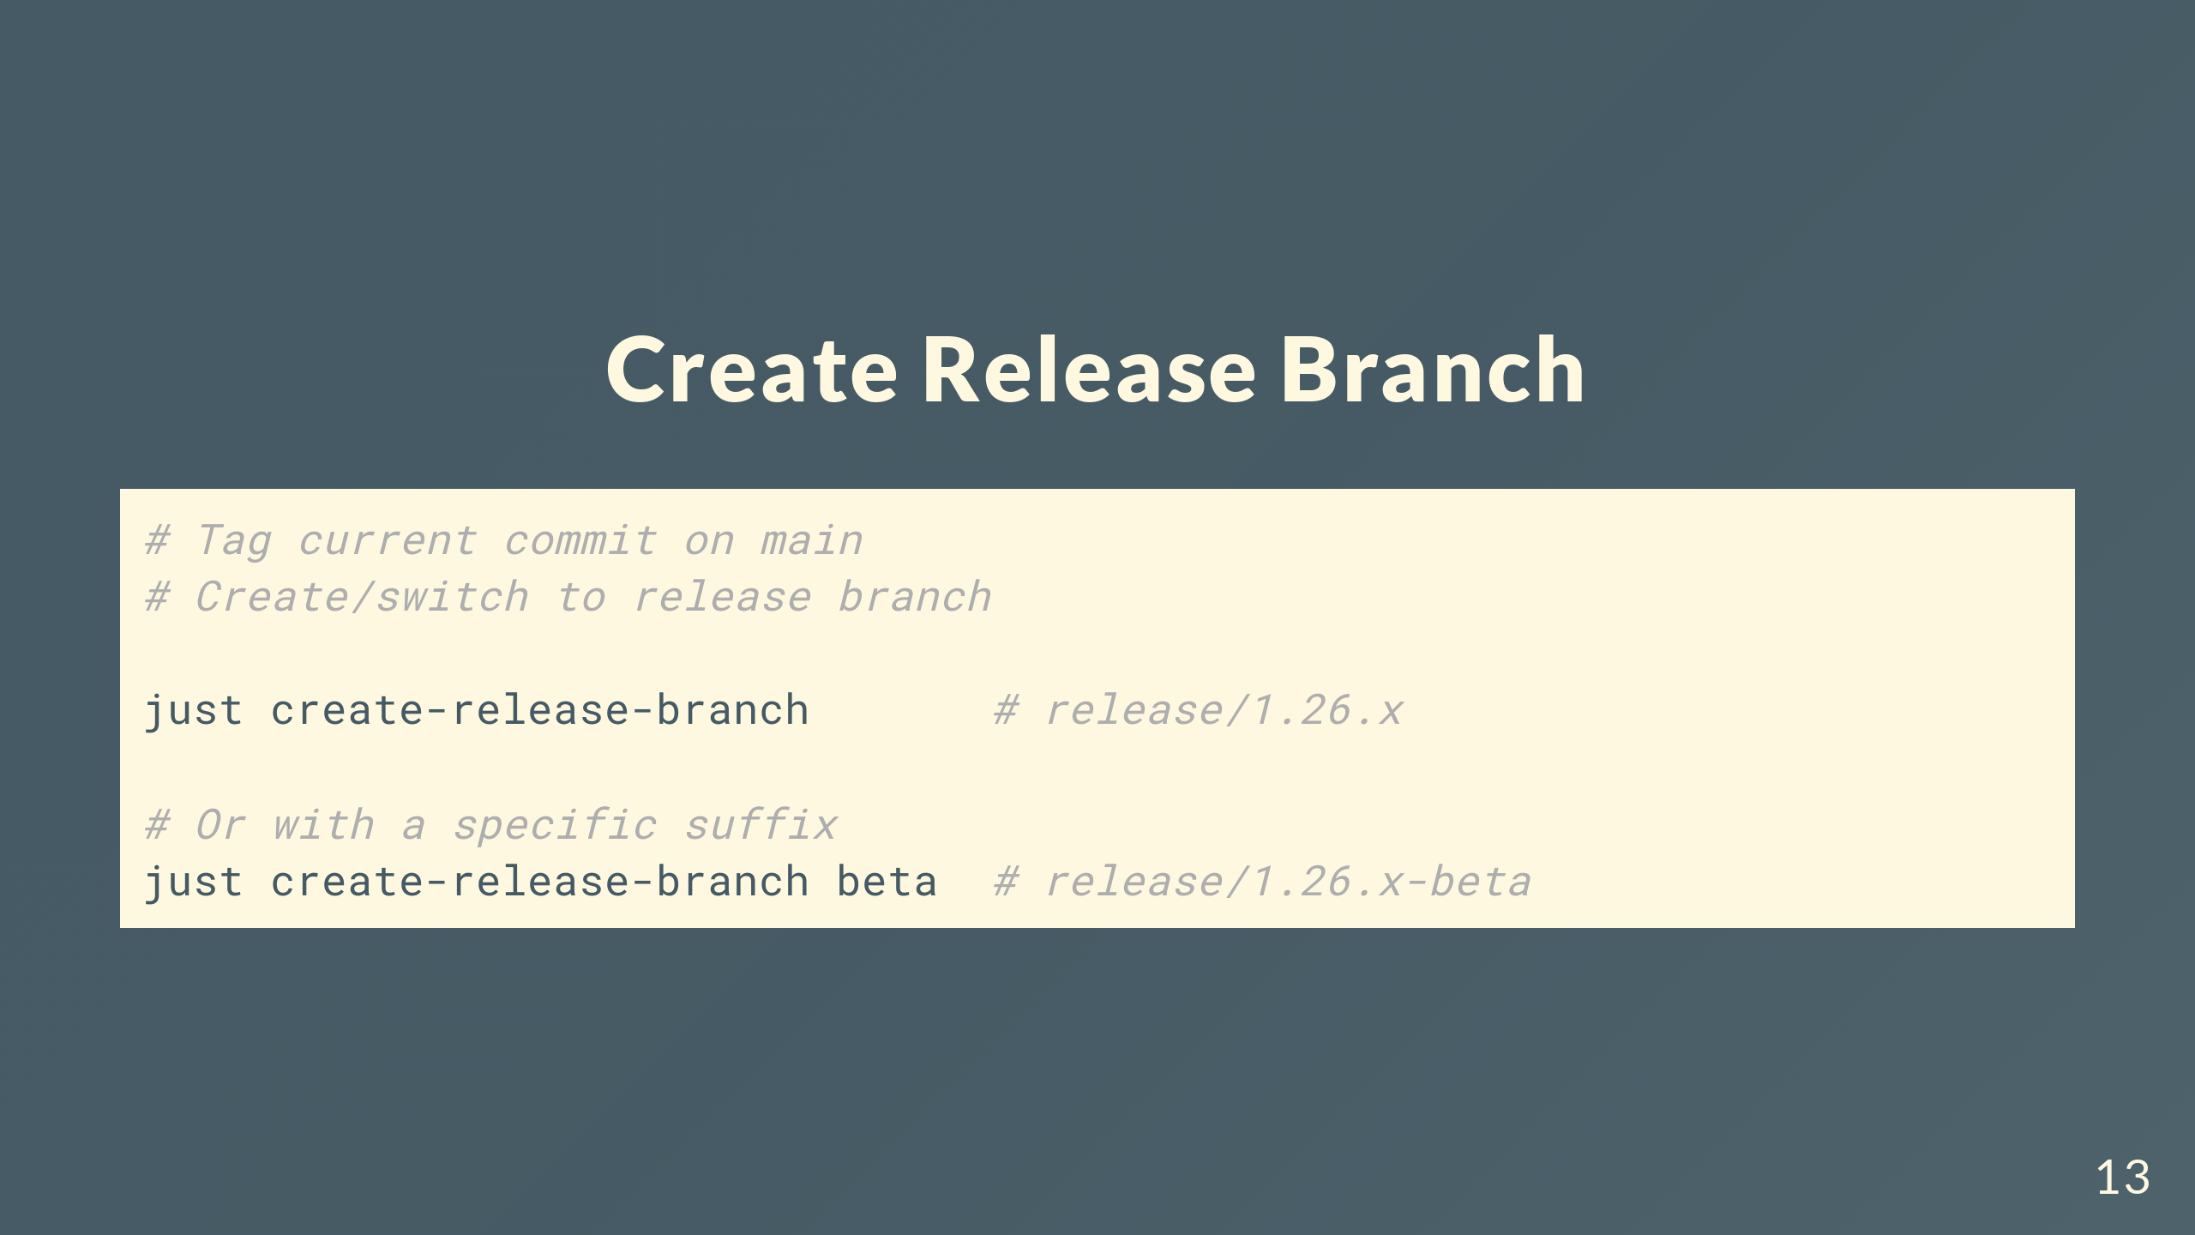
Notes:
Create release branch tags current commit on main, makes the branch from that tag. Can add a suffix like beta if you want. Branch name has major.minor with x for patch.

Slide 14
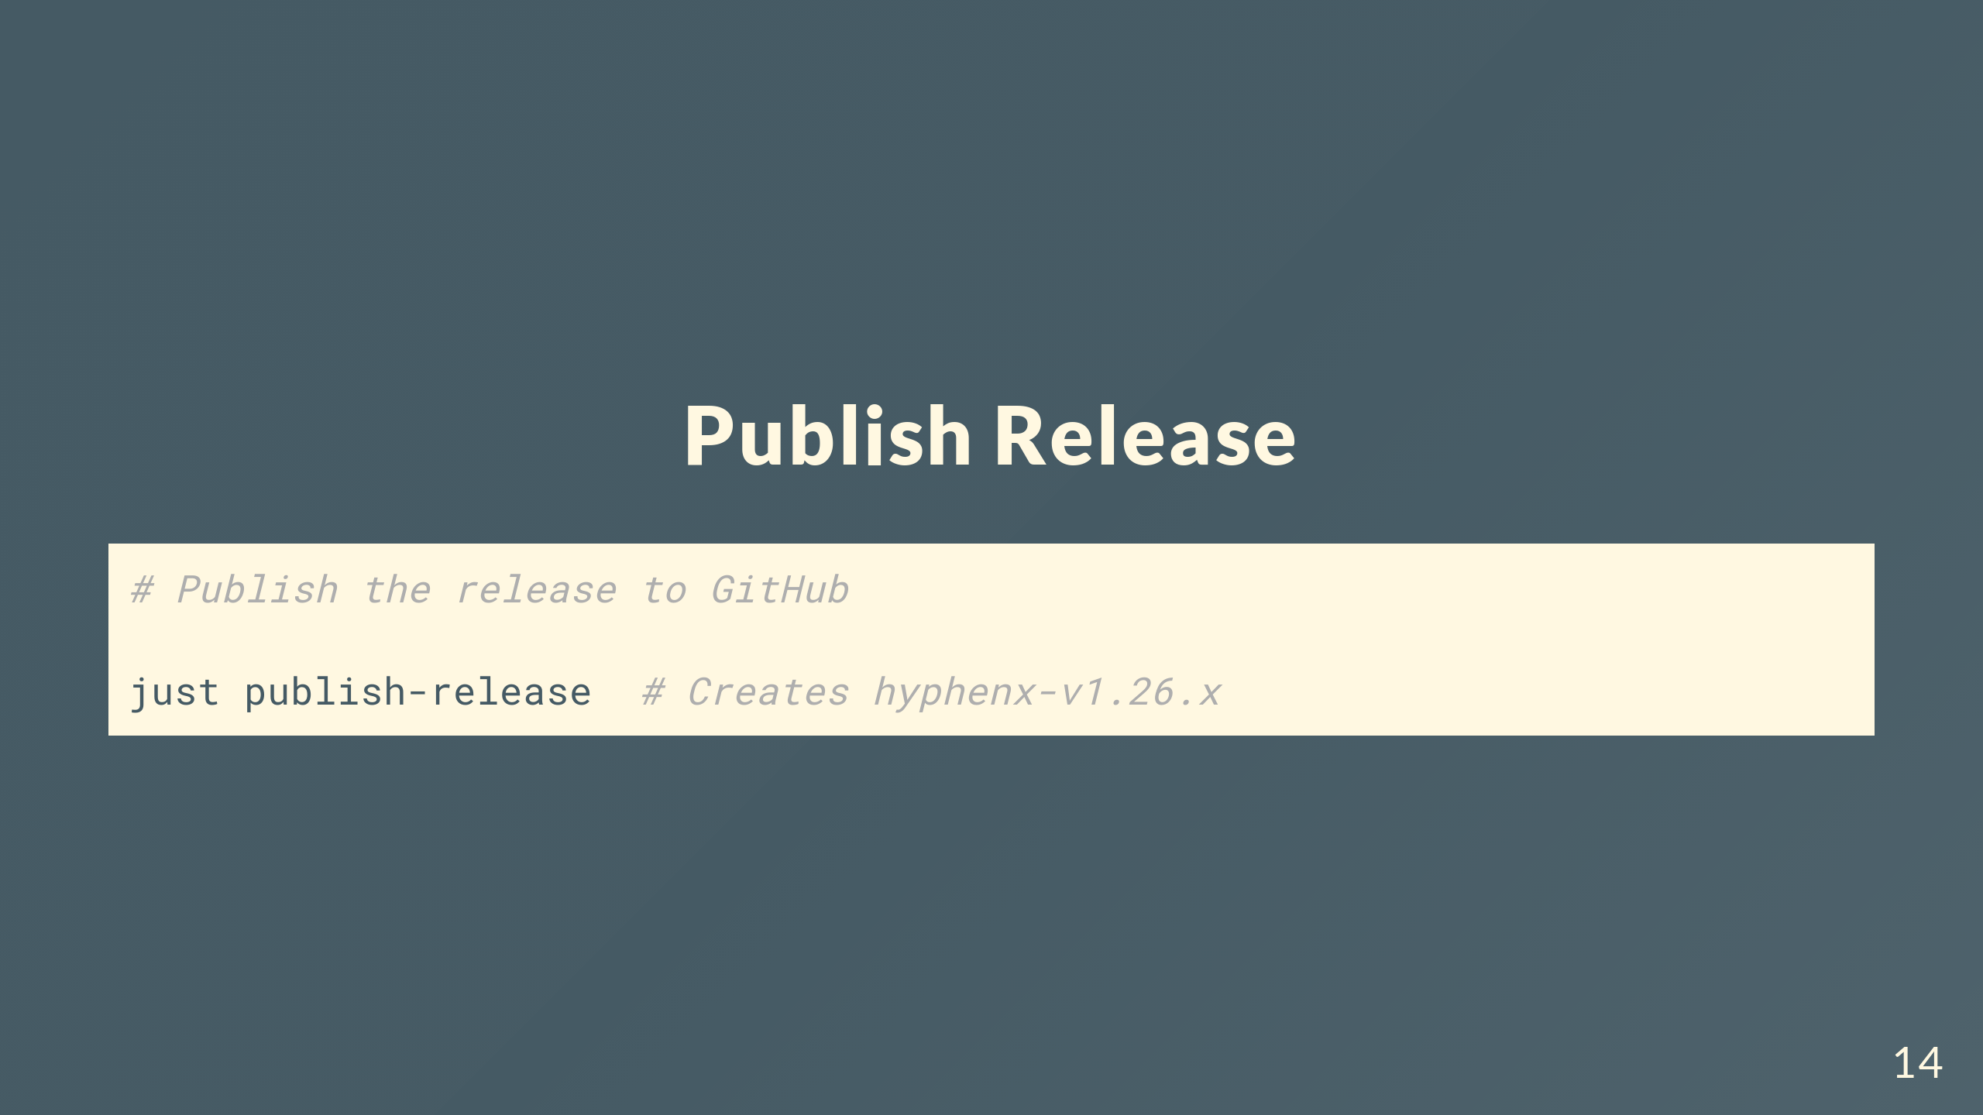
Notes:
Publishing creates the GitHub release with artifacts. Pulls version from current branch, makes the tag.

Slide 15
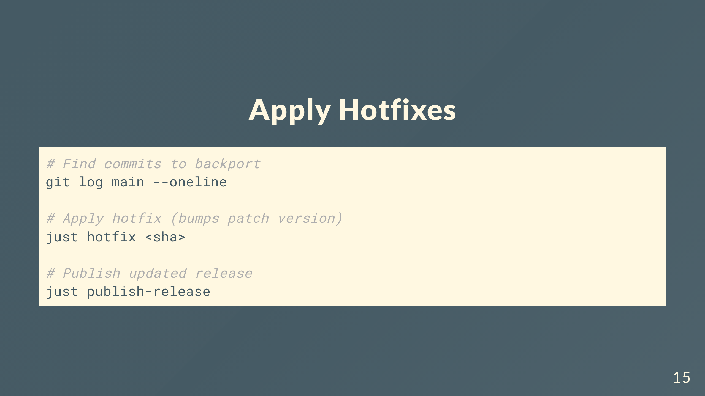
Notes:
Find the commit from main you want. Run just hotfix with the SHA, cherry-picks it and bumps patch. Publish.

Slide 16
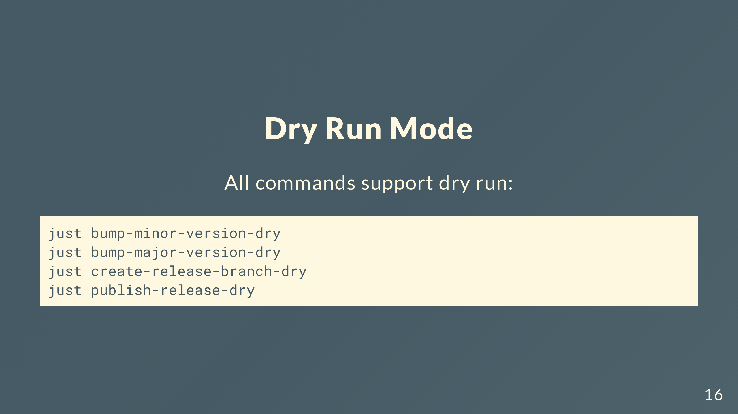
Notes:
Every command has dry run mode. See what happens without changing anything. Good for checking before you run it for real.

Slide 17
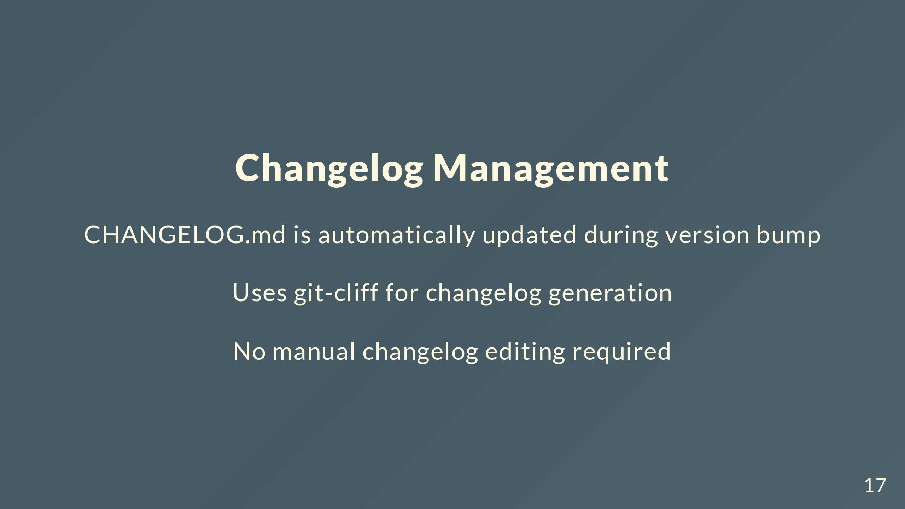
Notes:
Changelog's still automated. Using git-cliff instead of release-please's thing. Looks at conventional commits, generates during version bump. Never touch CHANGELOG.md yourself.

Slide 18
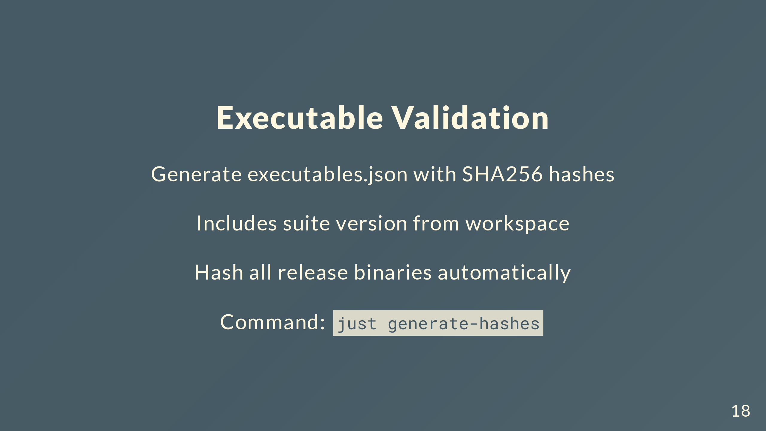
Notes:
Validation feature. Generate executables.json with SHA256 hashes of all release binaries. Has suite version and hash for each executable. Just run generate-hashes.

Slide 19
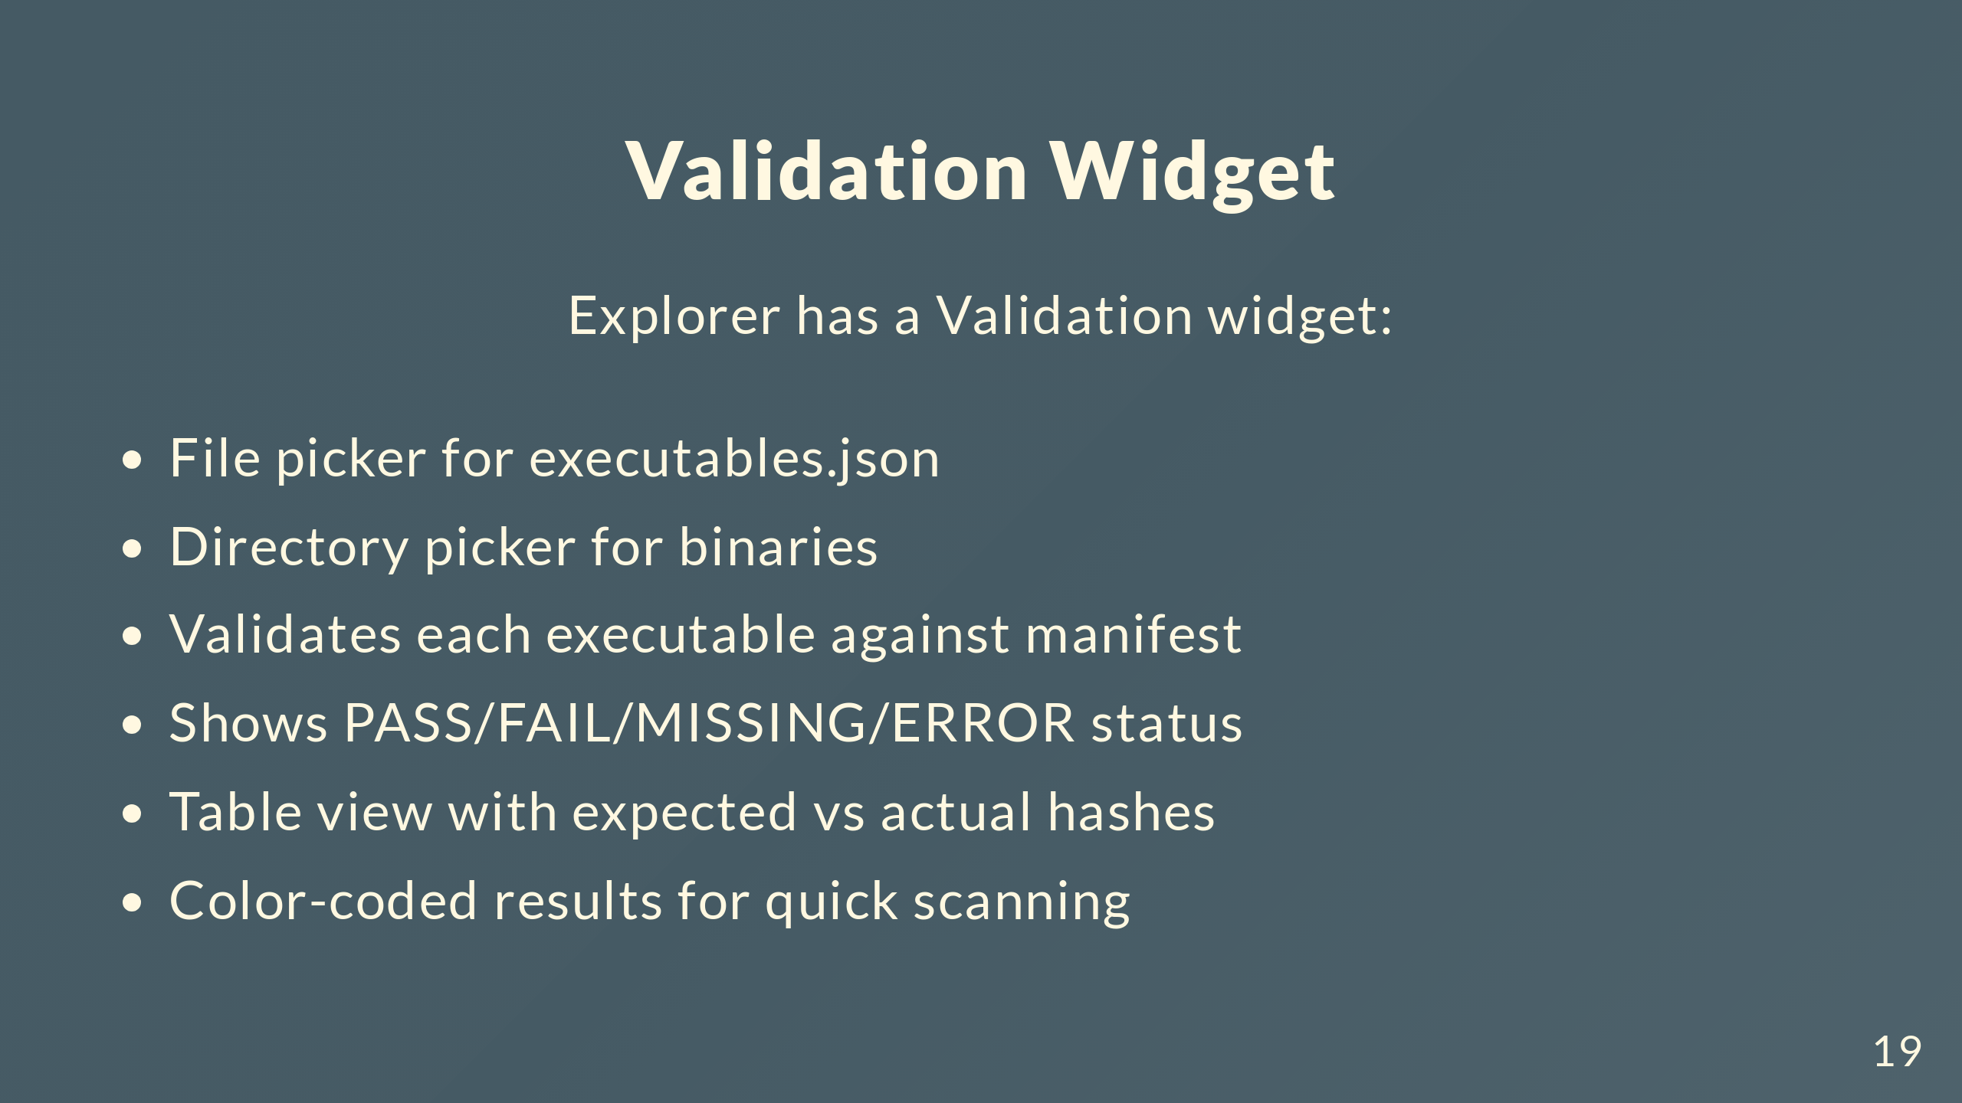
Notes:
Explorer has a validation widget. Pick executables.json, pick your binaries directory, validates everything. Table shows PASS/FAIL/MISSING/ERROR for each one, expected vs actual hashes. Color-coded so you can scan it quick.

Slide 20
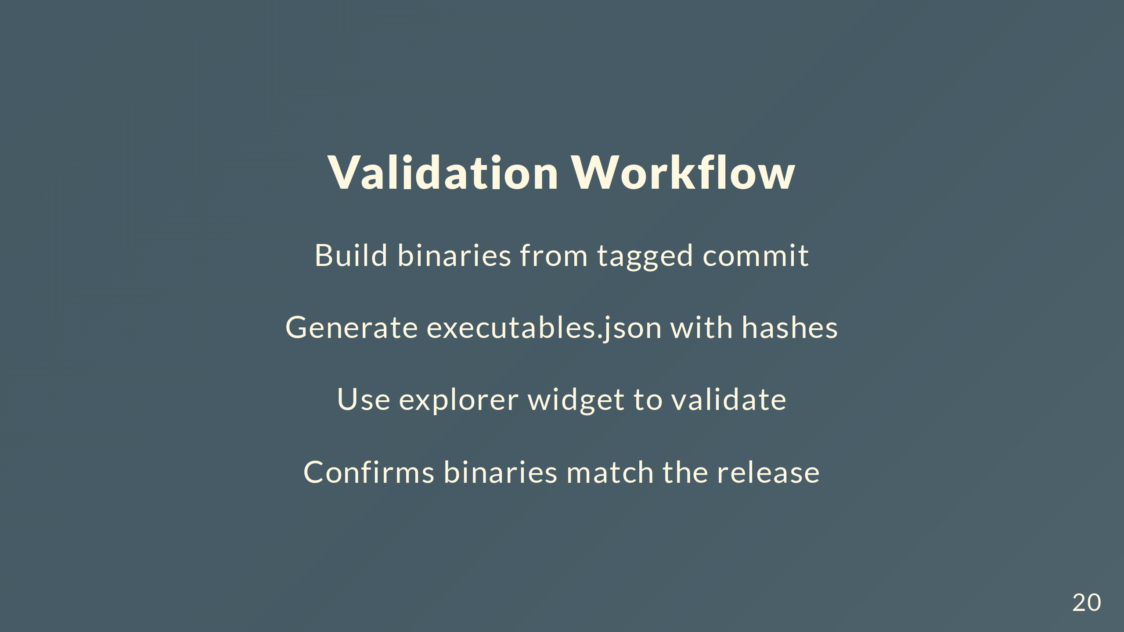
Notes:
Build binaries from tagged commit, generate executables.json, validate with explorer widget. Confirms what you're shipping matches what you think you're shipping.

Slide 21
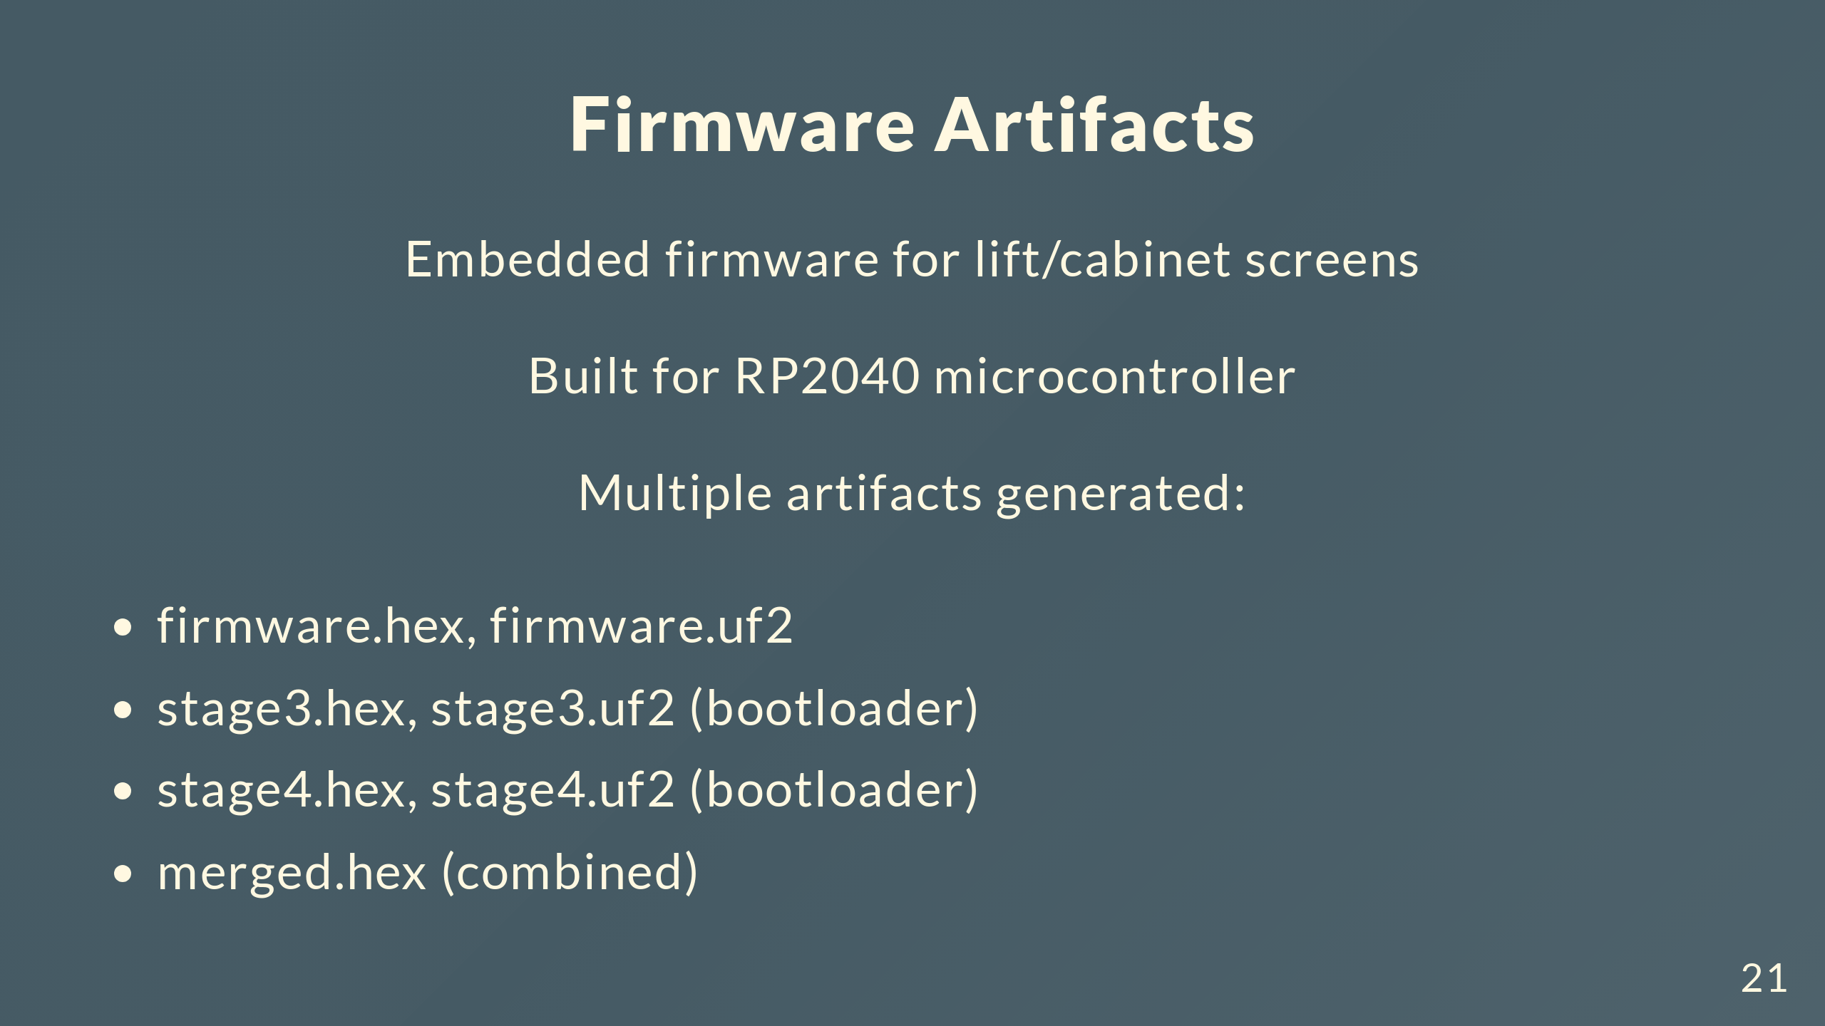
Notes:
What gets built. Embedded firmware for lift and cabinet screens - RP2040 microcontrollers. Multiple formats: firmware in hex and uf2, bootloader stages 3 and 4 in both, and merged hex with everything combined.

Slide 22
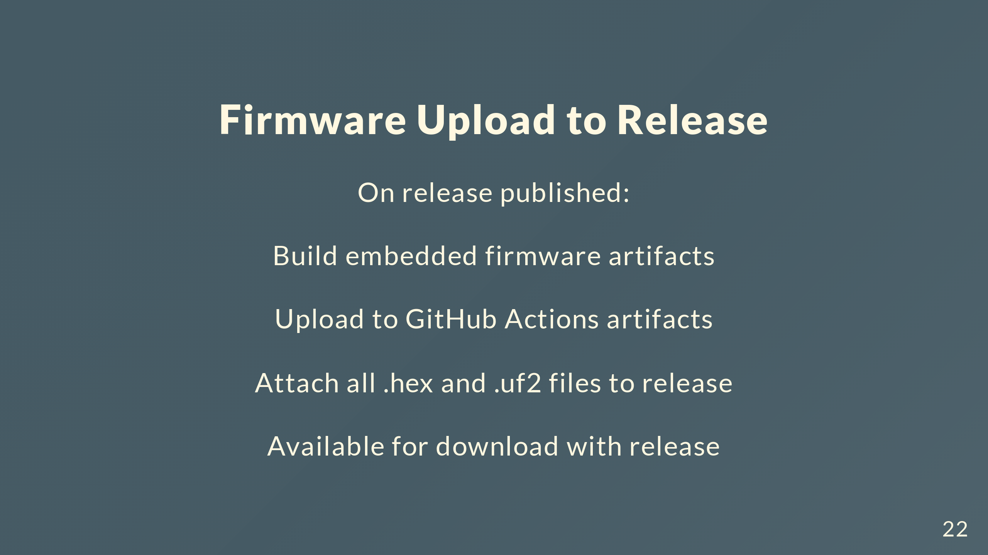
Notes:
Publish a release, workflow builds firmware artifacts, uploads to GitHub Actions, attaches all the hex and uf2 files to the release. Download the release and you get everything.

Slide 23
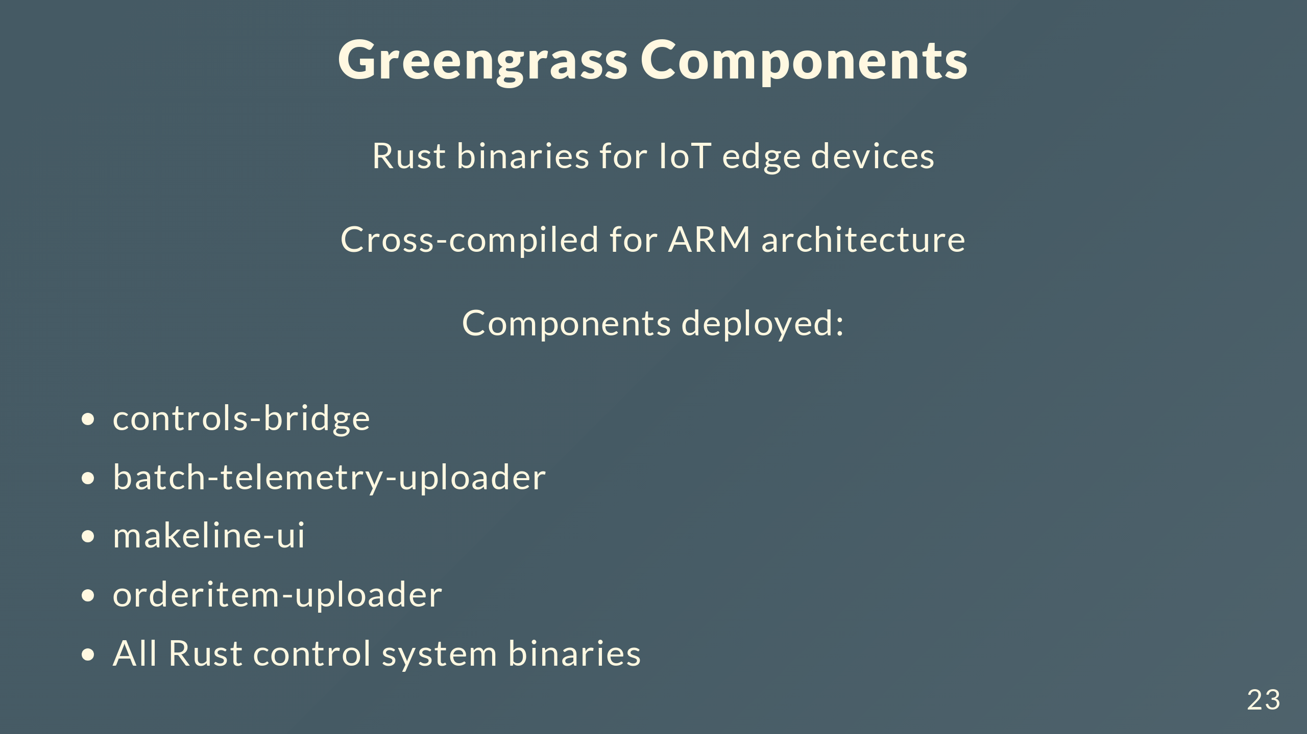
Notes:
Greengrass components are Rust binaries for IoT edge devices. Cross-compiled for ARM. Main ones: controls-bridge manages the control system, batch-telemetry-uploader sends telemetry, makeline-ui for the interface, orderitem-uploader, and all the control system stuff.

Slide 24
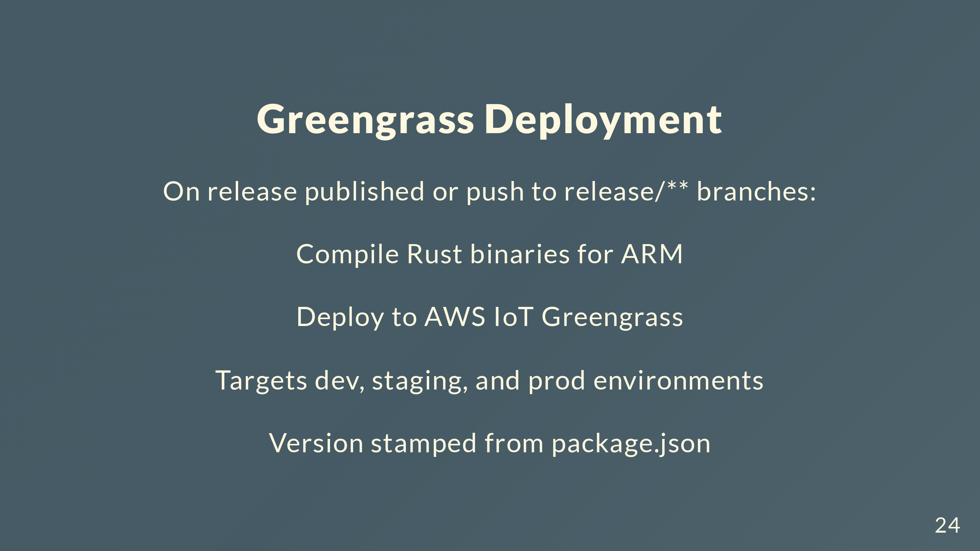
Notes:
Publish a release or push to release branches, kicks off deployment. Compiles Rust binaries for ARM, deploys to AWS IoT Greengrass. Hits dev, staging, prod. Version from package.json so we know what's where.

Slide 25
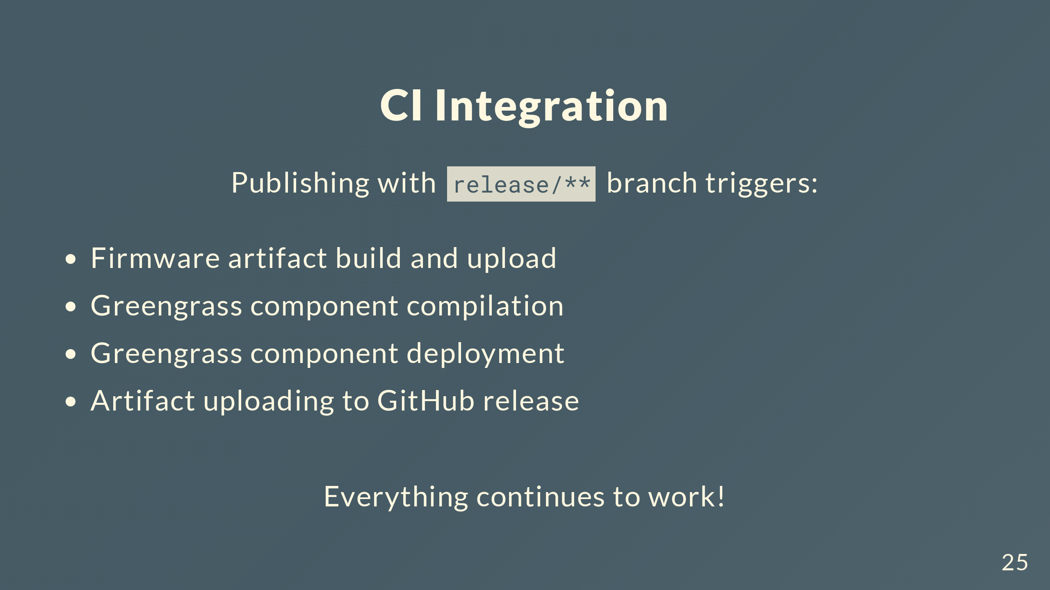
Notes:
Key thing: all the existing CI still works. Publishing on release branches still triggers firmware builds, Greengrass compilation and deployment, artifact uploads. Not breaking anything, just changing how we make and manage releases.

Slide 26
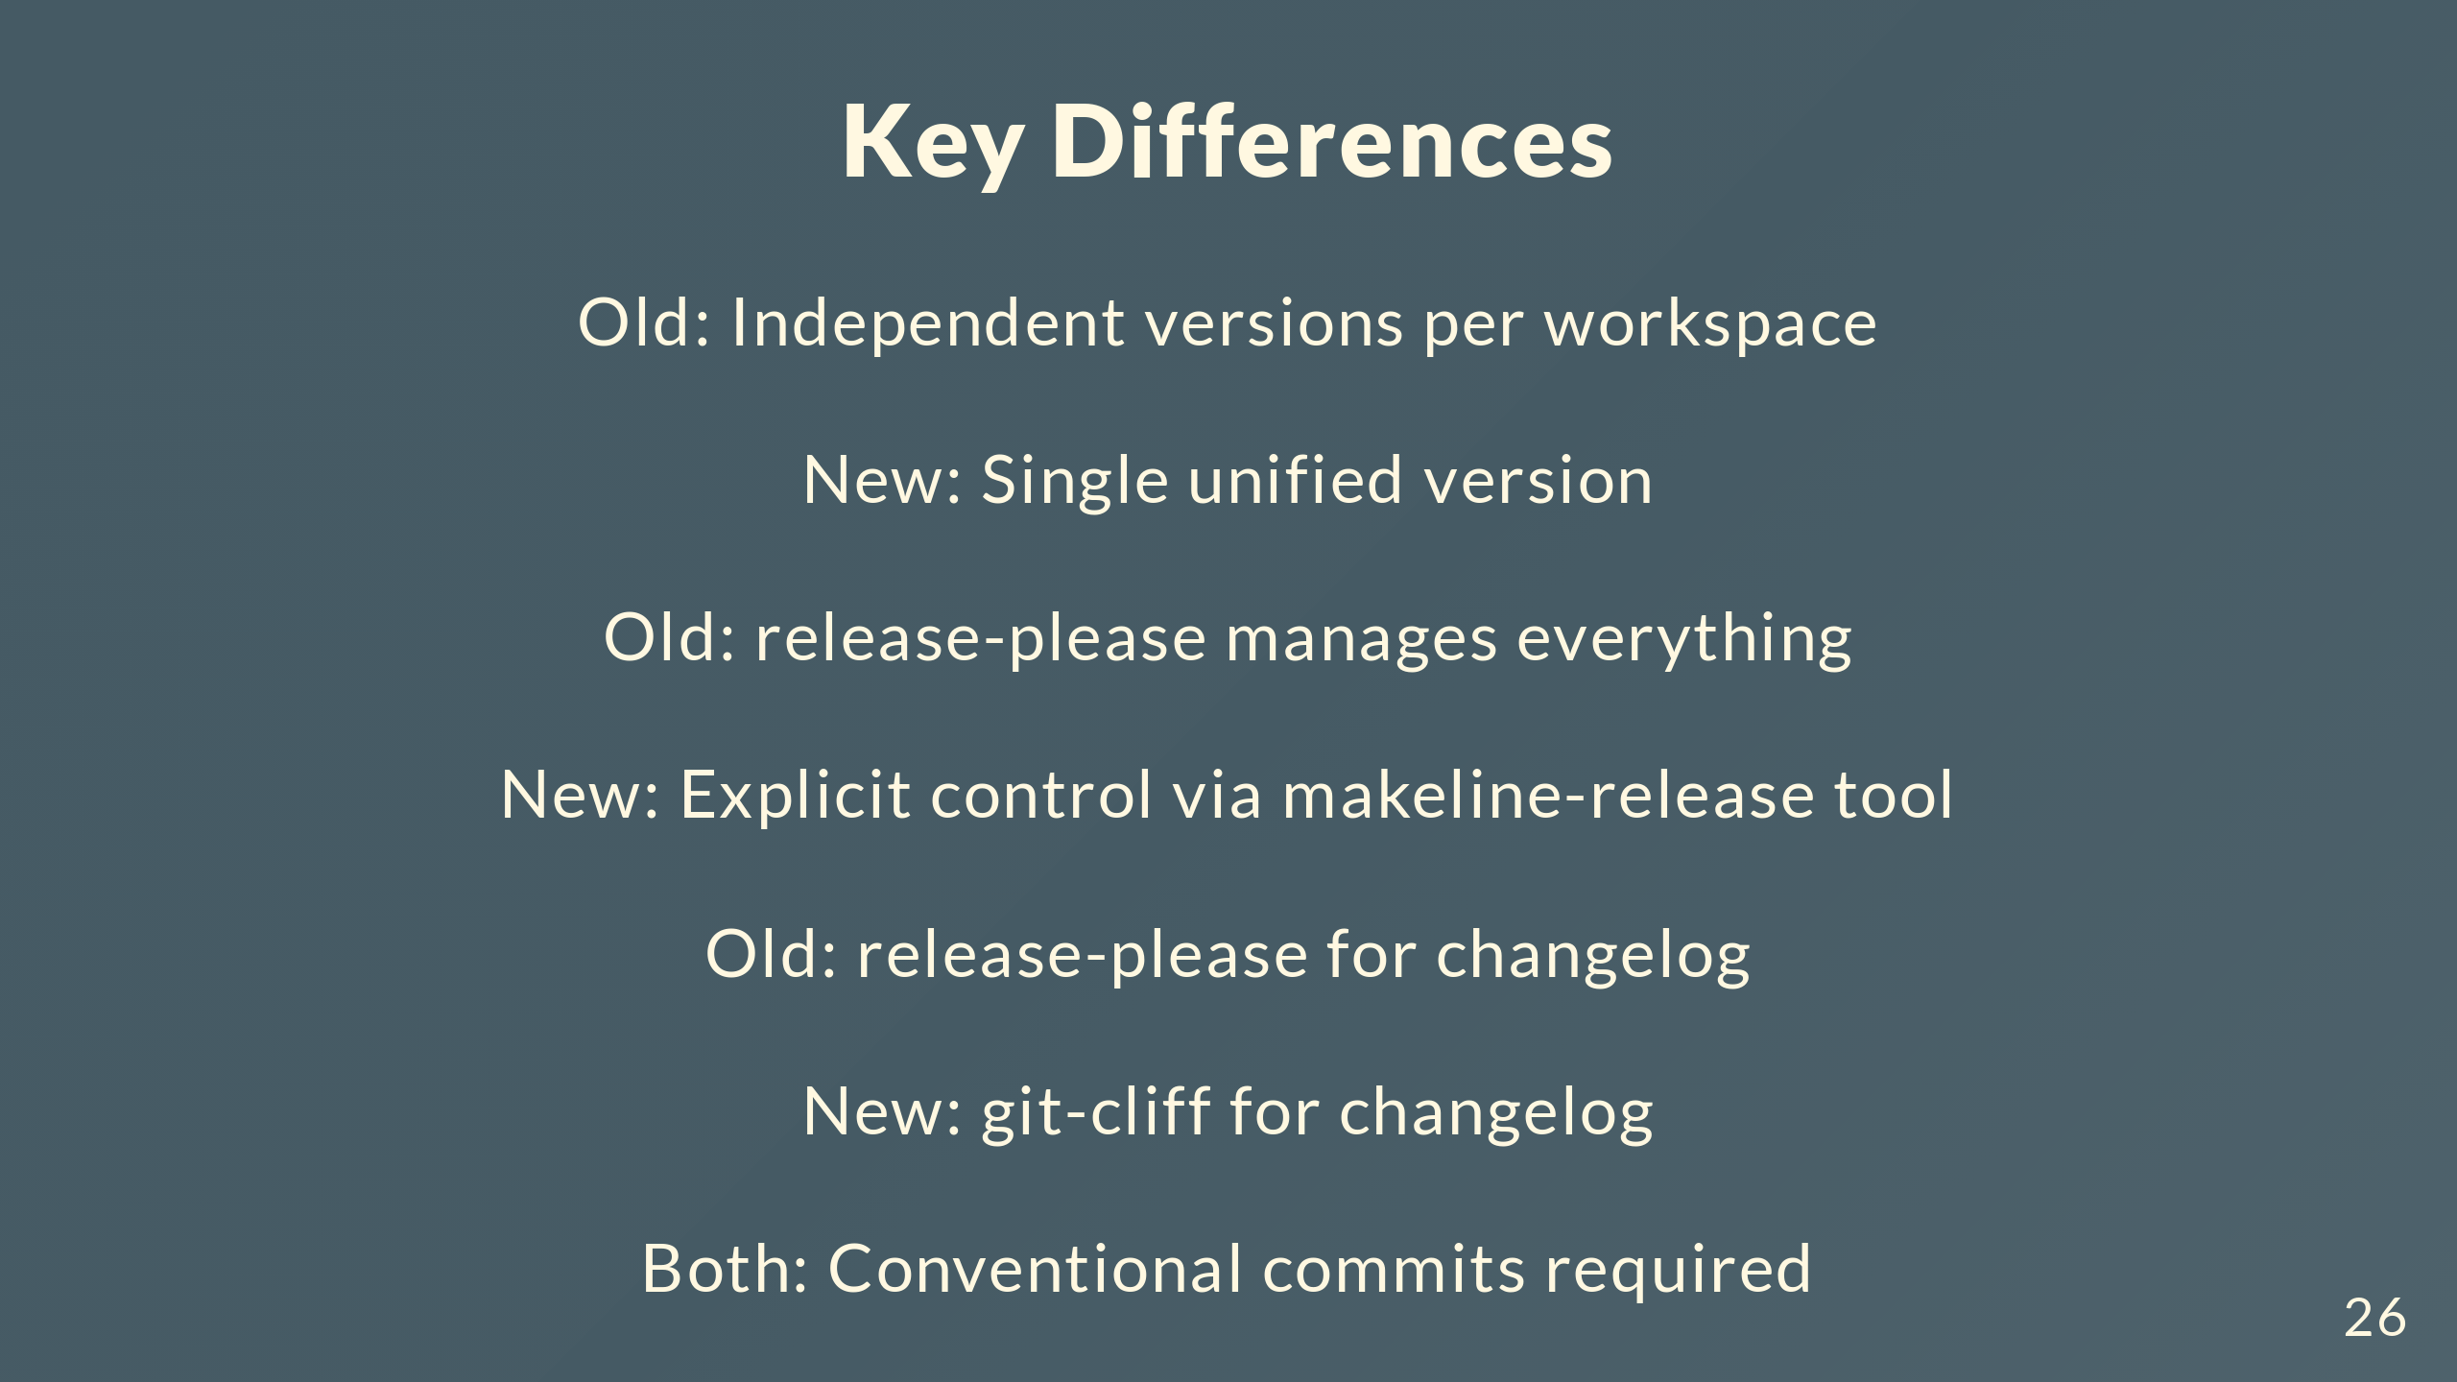
Notes:
Main differences. Old way: independent versions per workspace. New: single version. Old: release-please does everything. New: explicit control with makeline-release. Switching from release-please's changelog to git-cliff. Both need conventional commits though, so devs don't change anything there.

Slide 27
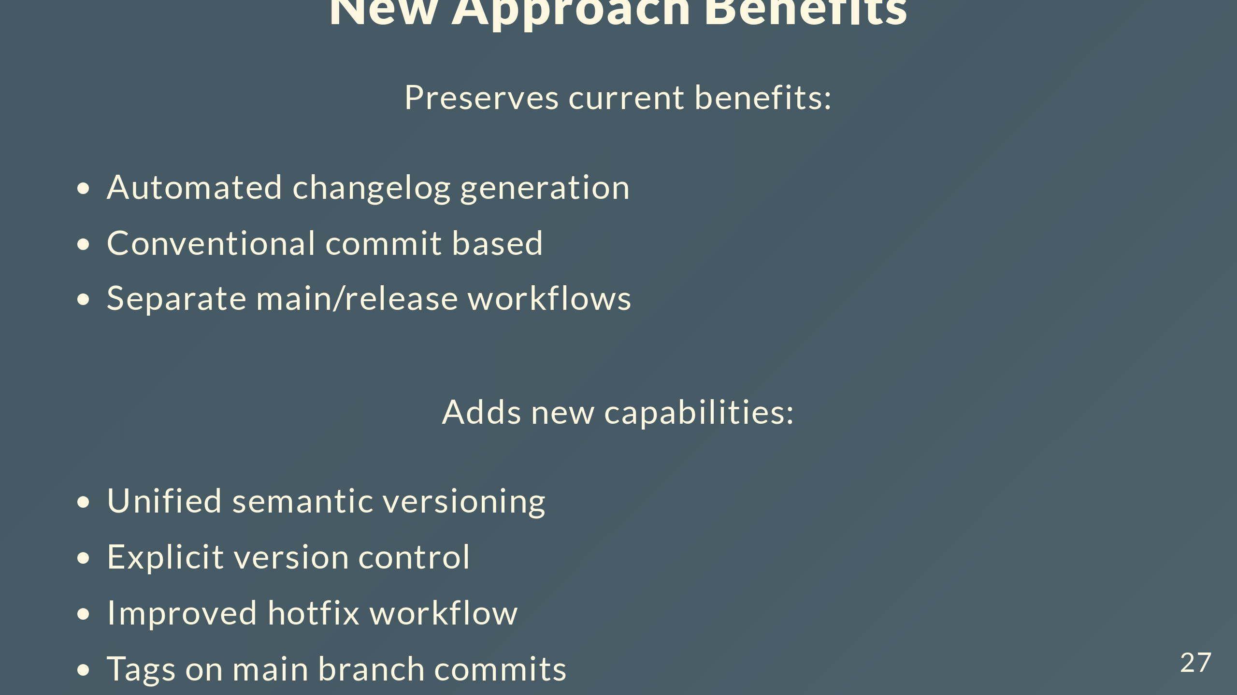
Notes:
What do we get? Keep the good stuff: automated changelogs, conventional commits, separate main and release workflows. Add new stuff: unified versioning across everything, explicit control over releases, simpler hotfixes, tags on main that mark releases. Automation where it helps, control where we need it.

Slide 28

Notes:
That's the new release strategy. Questions?

